Slide 1

Team Name : Assemblers
Team Leader Name : Sandeep Udeg
Problem Statement : AI for Rural Innovation & Sustainable Systems

Slide 2

Project Title: Gram-Setu (The Unified Rural Resilience Engine)
The Vision
Gram-Setu is a Unified Rural Ecosystem (URE) platform designed to bridge the digital divide for India’s heartland. Instead of isolated tools, we provide a Multi-Agent "Operating System" that manages the three most critical pillars of rural life: agricultural health, government welfare access, and sustainable resource management.
The Core Solution
Our solution employs a Supervisor-Worker architecture to act as a proactive digital companion for rural citizens:
      The Orchestrator: A central "Supervisor" agent that manages intent and conversation state, ensuring that data flows seamlessly between domains.
Agri-Expert Worker: Provides instant crop disease diagnosis using multimodal vision grounded in the Plant Village dataset and connects users to real-time Mandi prices.
Policy-Navigator Worker: Simplifies complex government schemes (like PM-Kisan and PKVY) using RAG (Retrieval-Augmented Generation) to provide eligibility-checked, hallucination-free advice.
Eco-Resource Worker: Processes soil and weather data to provide precise irrigation and energy schedules, significantly reducing resource waste.
Technical Architecture
Intelligence: Powered by Claude 3.5 Sonnet via Amazon Bedrock for high-fidelity reasoning.
Orchestration: Built using the Strands Agents SDK for modular, agentic workflows.
Data Strategy: Uses Amazon S3 for image and sensor log storage, with Bedrock Knowledge Bases for grounding policy advice in verified datasets.
Responsible AI: Integrated with Bedrock Guardrails to ensure all advice is safe, culturally sensitive, and privacy-compliant.
Impact & Scalability
Gram-Setu is built to be voice-first and multilingual, making it accessible to users regardless of their literacy level. By optimizing resource use and providing direct market/subsidy linkages, the platform aims to increase net farmer income by 18–22% while reducing water consumption by up to 45%.

Slide 3
Your solution should be able to explain the following:
How different is it from any of the other existing ideas? : Use reference : https://deepsky.ai/website/06ac7601-9369-446c-9e42-7b55bca86381_stored_entities → Priyanka
How will it be able to solve the problem? : need to thing
USP of the proposed solution need to think

Slide 4
List of features offered by the solution
It is always better to add a few visual representations (drawings/sketches/illustrations etc.) to your presentation, it adds to the power through which it reaches the audience.
Ganesh

Slide 5
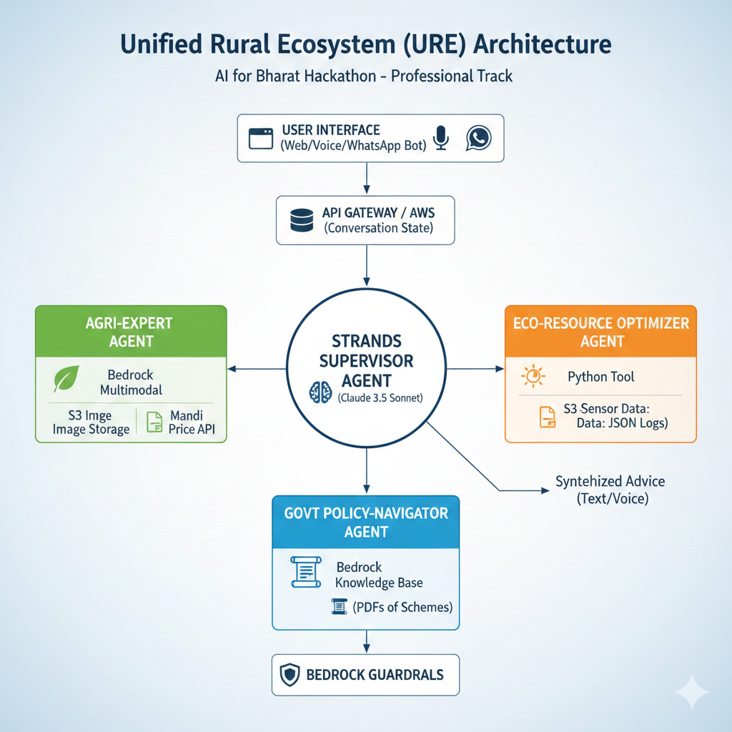
Process flow diagram or Use-case diagram
Add a flow diagram or a use case diagram or an architecture diagram.
Sandeep
https://deepsky.ai/website/2f6e3279-0e17-449b-aaa1-ef44d58901c3_stored_entities

Slide 6
Wireframes/Mock diagrams of the proposed solution (optional)
Need to think

Slide 7
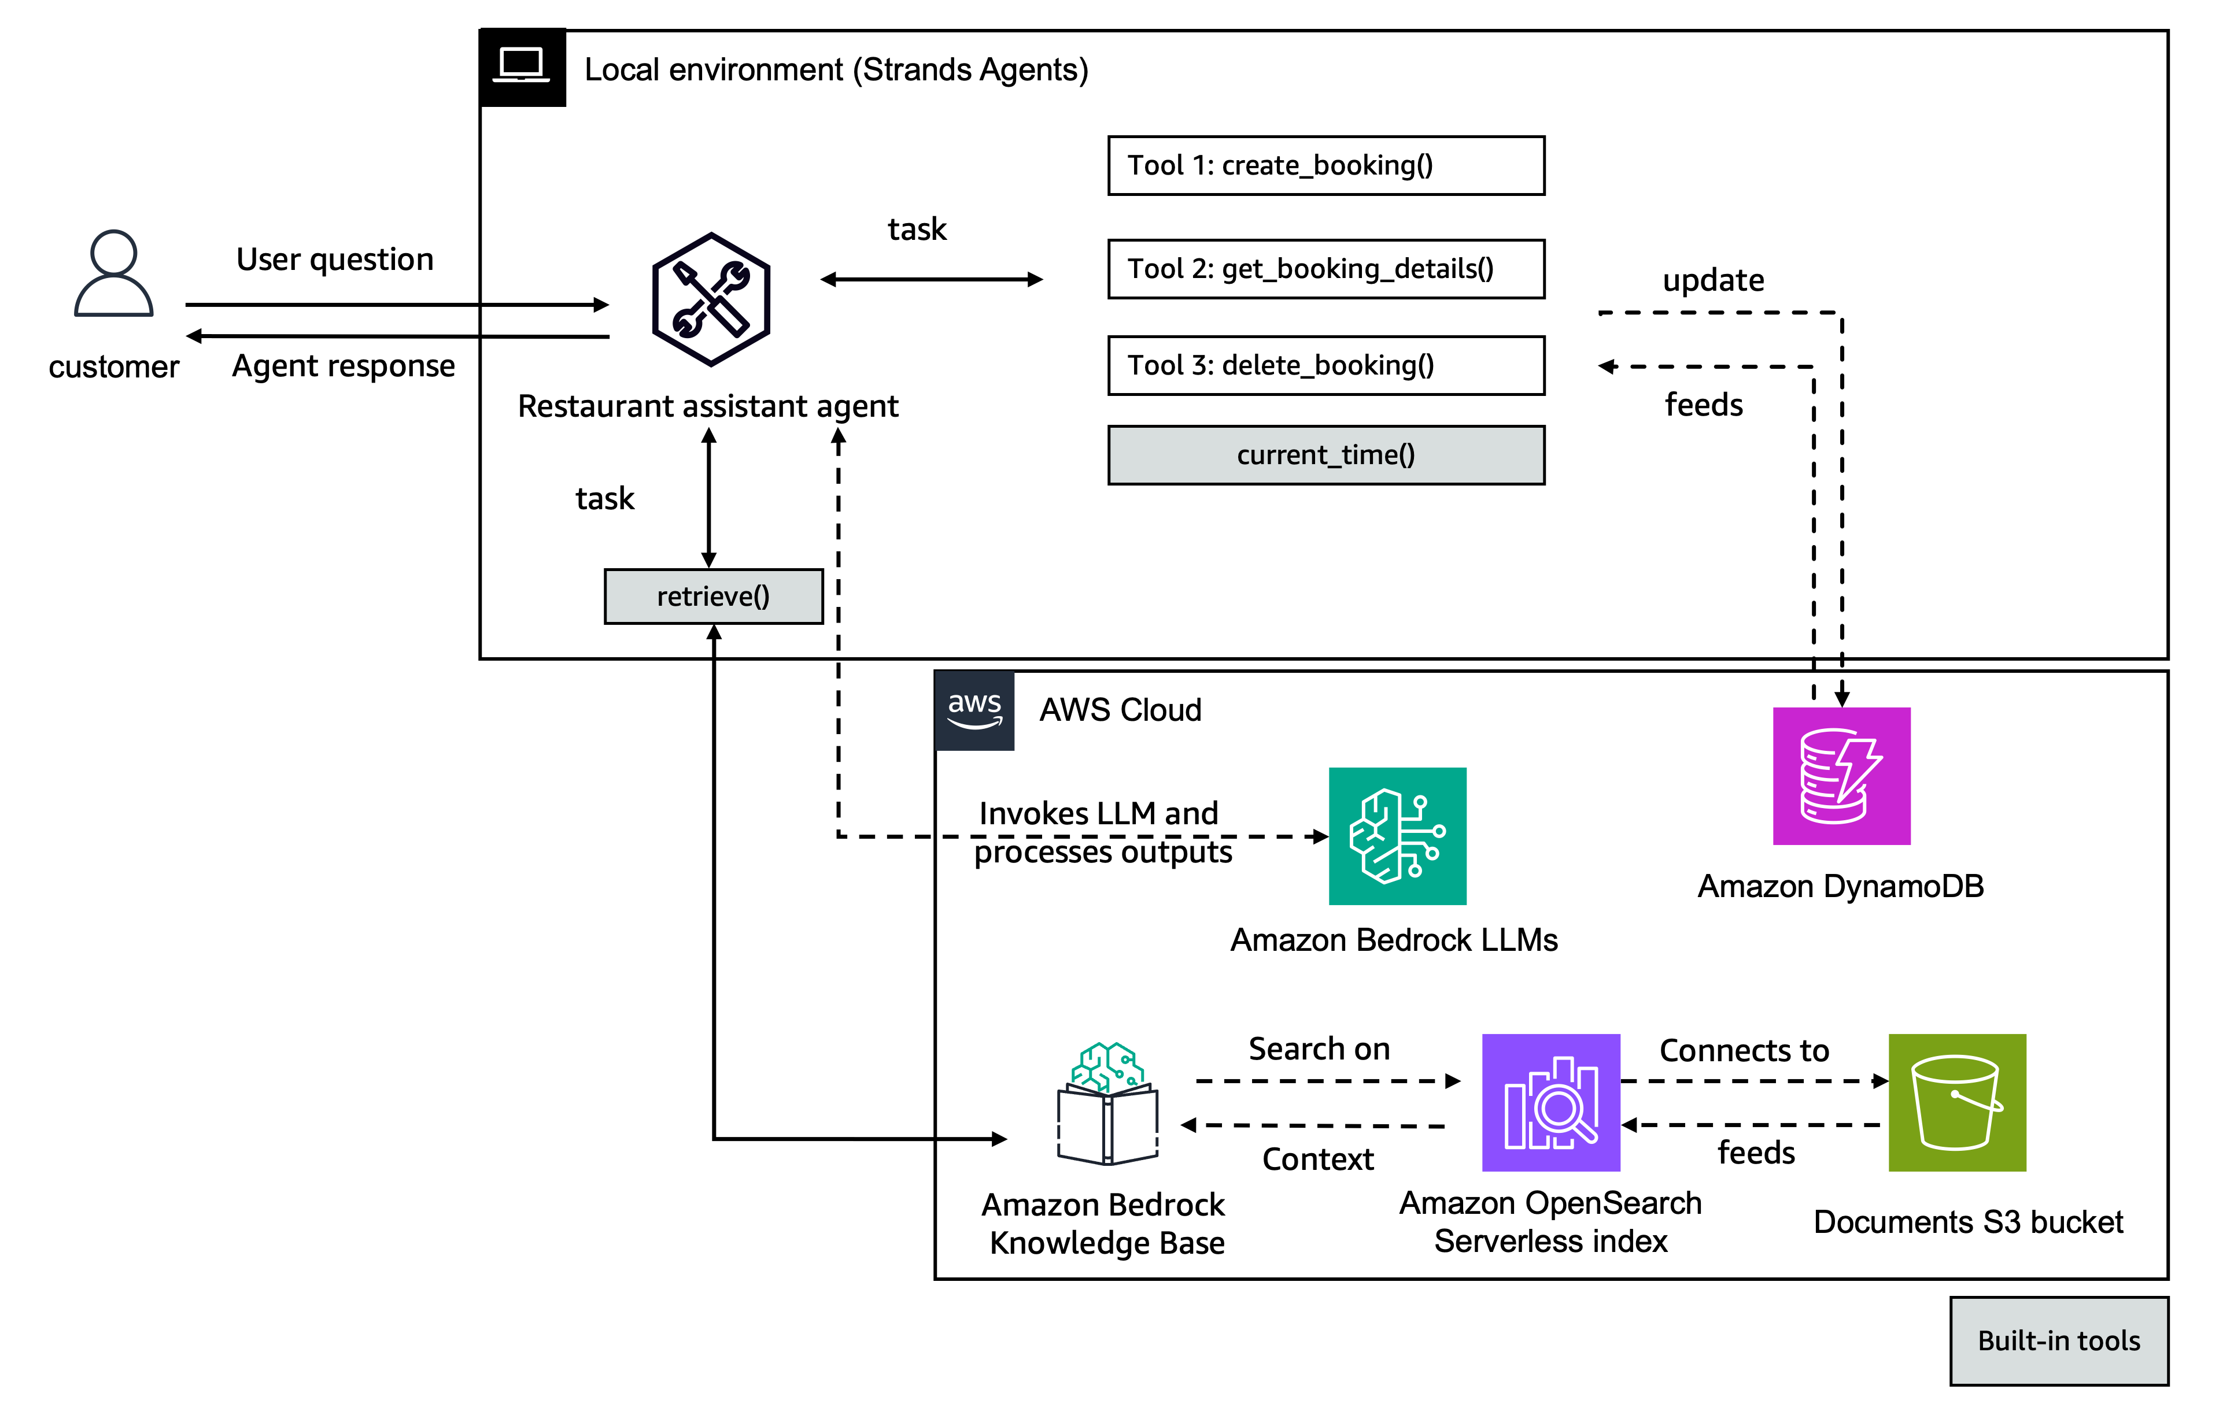
Architecture diagram of the proposed solution:
Ganesh
Need to use draw.io
Need to be in line with the problem statement

Slide 8
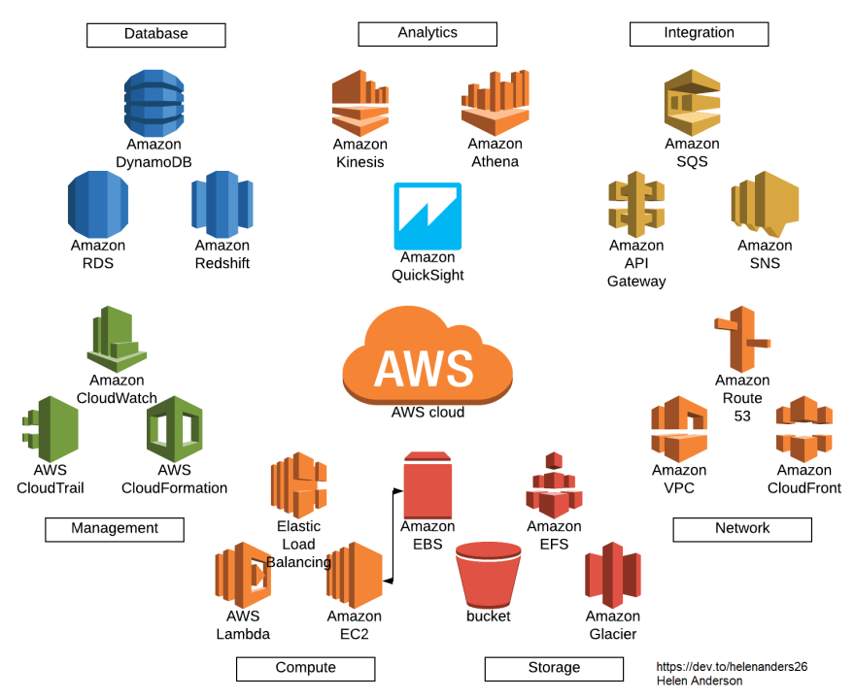
Technologies to be used in the solution:
List of AWS services that are to be used (Better to have the images of the respective tools)
Priyanka
Example only

Slide 9
Estimated implementation cost (optional):
https://deepsky.ai/share/168db2499b8d4b9187ade68c87463d79
Sandeep
Its optional not necessary to be provided

Slide 10
Add as per the requirements for the hackathon:

Slide 11


